Slide 1
Situation-Brewed Solutions
Developing a strategic & relevant problem-solving model with the Craig Gregersen Case (Dundis 2013).

Slide 2
Why are we here?
The Craig Gregersen Case ( Dundis, 2013) involved providing training to help each department understand their role in providing due diligence and documentation of such due diligence across a multinational organization. The goal is to create and implement a due diligence training. One result of the training is that a system of documenting of due diligence, in such a fashion that the laws of each country and district that the company called home is satisfied from a legal standpoint. There is not time to provide separate training to company branches but variances on the laws according to country and district must be considered. How do we get this done in a day but account for the variance of regulations worldwide?

Slide 3
Challenges
Multiple standardization organizations to appease
Multiple Departments in conflict over necessary solution
Bruised egos to work through
Multiple countries with different standards and understanding of “due diligence”

Slide 4
Step One: Prepare to Communicate by Research Key Terms and Concepts
Negligence: The omission to do something a reasonable man would do, guided by considerations that ordinarily regulate human affairs. Alternatively, doing something which a prudent and reasonable man would not do. It must be determined in all cases by reference to the situation and knowledge of the parties and all the attendant circumstances.
Resources:
Nitroglycerin Case, 15 Wall. 536, 21 I* Ed. 206; Blythe v. Birmingham Waterworks Co., 11 Evch. 7S4. Negligence, in its civil relation, is such an inadvertent imperfection, by a responsible human agent, In the discharge of a legal duty that immediately produces damage to another in an ordinary and natural sequence. Wiart. Neg.
Black’s Law Dictionary, Free 2nd Edition(n.d.) DUE DILIGENCE Definition & Meaning - Black's Law Dictionary. The
law dictionary. https://thelawdictionary.org/due-diligence/

Slide 5
Overview: Due Diligence
Such a measure of prudence, activity, or assiduity, as is to be expected from, and ordinarily exercised by, a reasonable and prudent man under the particular circumstances; not measured by any absolute standard, but depending on the relative facts of the special case.
Perry v. Cedar Falls, 87 Iowa, 315, 54 N. W. 225; Dillman v. Nadelhoffer, 1G0111. 121, 43 N. E. 378; Hendricks v. W. U. Tel. Co., 120 N. C. 304, 35 S. E. 543, 78Am. St. Rep. 058; Highland Ditch Co. v. Mumford. 5 Colo. 330.
Black’s Law Dictionary, Free 2nd Edition (n.d.)

Slide 6
Due diligence is commonly understood as …
Preventative
Risk-Based ( Severity & Likelihood = Prioritization)
Dynamic and requires ongoing activity
Does not shift responsibilities
Involves multiple processes and objectives
Commensurate with risk
Concerns internationally recognized standards for responsible business conduct
Appropriate to the enterprise’s circumstances
Adaptable to deal with limitations of working business relationships
Informed by engagement with stakeholders
Involves ongoing communication

Slide 7
OECD (2018)
BOX 1. UNDERSTANDING RISK UNDER THE OECD GUIDELINES FOR MNES For many enterprises, the term “risk” means primarily risks to the enterprise – financial risk, market risk, operational risk, reputational risk, etc. Enterprises are concerned with their position in the market vis-à-vis their competitors, their image, and long-term existence, so when they look at risks, it is typically risks to themselves. The Guidelines, however, refer to the likelihood of adverse impacts on people, the environment, and society that enterprises cause, contribute to, or to which they are directly linked. In other words, it is an outward-facing approach to risk. Enterprises can identify risks on RBC issues by looking for divergences between what is recommended in the OECD Guidelines for MNEs on the one hand and the circumstances associated with their operations, supply chains, or business relationships on the other.

Slide 8
Understand International Definitions of Due Process
The EU statement points out that the need to exercise due diligence is “consistent with international law and 2010, 2013, and 2015 consensus reports of the United Nations Groups of Governmental Experts (UNGGEs) in the field of Information and Telecommunications in the Context of International Security.” Due diligence was indeed described as a norm in the UNGGE report of 2015 (paragraph 13h [PDF]) ( Van Der Meer, 2020)

Slide 9

2. Consider the target goal: The impact of the strategic plan must learning objects must…
Prevent potential harm to consumers and the community
Apply to worldwide markets with different standards and laws
Provide evidence of due diligence through documentation
Prevent lawsuits from occurring

Slide 10
3. Interview SME’s (Communicate) to understand
Use the “five whys” to understand each department’s needs and concerns fully.
Filter the solution through multiple sieves so that the end product and/ or interventions meet the needs of multiple departments and consider departmental structure and constraints.

Slide 11
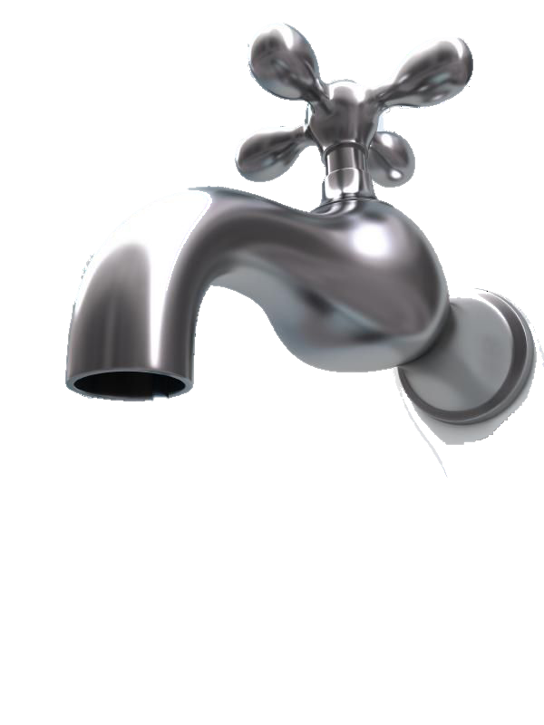

Questions For Potential Solutions
Potential Problems

Slide 12





Questions For Potential Solutions
Find the Key
Problem
Multiple standards from many different countries and different standardizing organizations to comply with, but only one training session is available due to time constraints.
What does the country in question state?
Can we group countries with similar regulations?
What is the highest standard with-in that group?

Slide 13

Questions For Potential Solutions
Problem
Multiple standards from many different countries and organizations to comply with, but only one training session is available due to time constraints.
What is the common thread between standardizing organizations?
What does the country in question state?
What do standardizing organizations currently state?
How are these common threads similar and different from the legal standards?

Slide 14
Questions For Potential Solutions
Problem
Multiple standards from many different countries and organizations to comply with, but only one training session is available due to time constraints.
What does the professional community recommend?
What does the country in question state?
What do the standardizing organizations require?
Ask Each Department: Within your field of expertise, what would be considered reasonable?
Reasonable due diligence per area of expertise

Slide 15
What does the country in question state?
What do the standardizing organizations require?
Reasonable due diligence per area of expertise
Well Brewed Solution
TRAINING: Provide consolidated standards and definition of due diligence.
WORKSHOP: Each Department Develops a plan to conform to the statement with a plan for producing artifacts showing due diligence.

Slide 16
Questions & Possible Solutions
Problems
4. Summarize or define the problem
Changing Countries & Related laws – 16 plus (page 205)
Changing regulations by Standardizing Organizations ( page 205)
Reasonable Due Diligence within Professional Expertise
TRAINING: Provide consolidated standards and definition of due diligence.
WORKSHOP: Each Department Develops a plan to conform to the statement with a plan for producing artifacts showing due diligence.

Slide 17
5. Brainstorm with questions and possible solutions
What does the country in question state?
Legal advises Management
What do standardizing organizations currently state?
Management advises department experts.
What is prevailing wisdom in the field of expertise?
Training presents a target objective ( a consolidated definition of due diligence that will cover international and multi-organization requirements. )
Each Department develops a plan in a training workshop to comply and regularly produces due diligence artifacts.
Department experts advise and collaborate with management
What is a plan of action to ensure responsible action and due diligence?

Slide 18
6. Map out a Plan: Training Shares Standard
Departmental Develop a Compliance Plan Via Workshop.
Field engineering
Management
Department Expertise – Close Gaps
Management provides standardizing organization research & refines the definition of gaps.
Department Expertise – Close Gaps
Process engineering
Legal provides research and statements of law and defines gaps
Department Expertise – Close Gaps
Central Task:
Do due diligence to avoid harm to customers and avoid legal action.
Marketing & Sales
Department Expertise- Close Gaps
Production engineering
Department Expertise – Close Gaps
Department Expertise- Close Gaps
* Customer Service
Department Expertise – Close Gaps
Line Engineering

Slide 19
Check for systemic coherency & consistency.
Field engineering
Management
Management provides standardizing organization research & Guidance in the context of legal.
Process engineering
Legal provides research and statements of law.
Central Task:
Do due diligence to avoid harm to customers and avoid legal action.
Marketing & Sales
Production engineering
* Customer Service
Line Engineering
Check for systemic coherency & consistency.

Slide 20
7. Ensure that department plans from the workshop still align with the target objectives.
Field engineering
Check for systemic coherency & consistency.
Management
Management provides standardizing organization research & Guidance in the context of legal.
Process engineering
Legal provides research and statements of law.
Central Task:
Do due diligence to avoid harm to customers and avoid legal action.
Marketing & Sales
Production engineering
* Customer Service
Line Engineering
Check for systemic coherency & consistency.

Slide 21
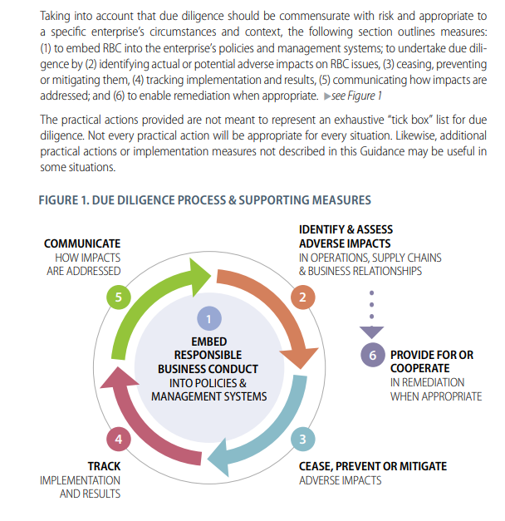
8. Tracking Impact – This is a step that must be planned for an embedded into the design process from the start. This allows for project evaluation and data based adjustments to ensure that effectiveness and quality is of the highest standard.
OECD, 2018. Used with permission

Slide 22
References
Black’s Law Dictionary, Free 2nd Edition(n.d.) DUE DILIGENCE Definition & Meaning - Black's Law Dictionary. The
law dictionary. https://thelawdictionary.org/due-diligence/
Dundis, Steven (2013) Case study 22 Craig Gregersen: Balancing a range of stakeholder interests when
designing Instruction. Ertmer case studies in instructional design, 5th edition 2019. Routledge, Milton Park, United Kingdom.
OECD (2018), OECD Due diligence guidance for responsible business conduct. Design: Peggy King Cointepas
OECD (n.d). Home page - OECD ( Organization for Economic Co-operation and Development. Oecd.
https://www.oecd.org
van der Meer, S. (2020, March 12). Could the Coronavirus Crisis Strengthen Due Diligence in Cyberspace? | Council on Foreign Relations. Cfr. https://www.cfr.org/blog/could-coronavirus-crisis-strengthen-due-
diligence-cyberspace

